Slide 1
The Impact of Financial Crisis of 2008 on the Housing Market and the Retail Industry
Student’s Name
Institutional Affiliation

Slide 2
INTRODUCTION
The financial crisis represents the deadliest global economic crisis in the 21st century after the great depression of 1930s.
The crisis hit the financial sector the hardest although other sectors such as the retail industry also faced adverse implications.
The Great economic recession has had a huge impact over a lengthy period while the global economic environment has since changed.
Notes:
The financial crisis envisioned a great economic recession and resulted to subprime mortgages market in the USA and later spread to Europe. Prior to the crisis, the US housing market was in a boom while attracting a high risk of unanticipated demand. The boom in the housing sector which came to be identified as the housing bubble led to an increased demand for subprime mortgages. A housing bubble encompasses a scenario whereby there is a run-up in housing prices fueled by demand, speculation among other factors. The early signs of the housing bubble showed up in 2007 and the crisis crept in in December 2007 (Ghadami, Aghaie, & Mohammadkhan, 2010). in the following year, the crisis magnified and fast spread to other parts of Europe leading to rapid decision by different governments to have a stake in their respective banking sectors.

Slide 3
Causes of the great recession
International trade imbalances
Lack of Government regulation
Limited regulation of non-depository financial institutions.
Existence of weak and fraudulent underwriting practices making it easier for unqualified investors to qualify for loans.
Notes:
The existing international trade imbalances acted as a stimulant to the rapid escalation of the financial crisis and its spread across to the rest of Europe. In essence, the existence of high lending standard bore a situation of high household debt which caused the eruption of the housing bubble (Ghadami, Aghaie, & Mohammadkhan, 2010). The US government also failed to impose relevant investment regulation leading to an increase in volatility of the financial markets. The financial market succumbed to increases shock and panics on investment where large financial institutions and banks came down causing a shake-up of the entire financial sector. The other cause of the financial crisis of 2008 was the lack of sufficient regulation on non-depository financial institutions which left them exposed to market volatility (Campello, Giambona, Graham, & Harvey, 2011). Lastly, the US financial system gave room to weak and fraudulent underwriting practices leading to a mix-up in the grant of loans even to unqualified investors. The shakeup in investment and financial industry escalated rapidly due to the ineffective underwriting system.

Slide 4
Imported economic implication of the Asian financial crisis.
Defaulting of loans and other forms of credit.
Failure by owners to pay back financial institution monthly mortgage payments.
Financial market uncertainties which rapidly escalated to critical levels.
Notes:
Following the ease with which credit was available to multiple investors even the unqualified ones, there were large inflows from the Asian financial crisis that were used to construct new houses. Banks also give out more loans. Furthermore, the investors started to default on the repayments of their loans which cause paralysis in the financial and banking industry. The housing sector further faced the dilemma of default on mortgage payments by homeowners which spurred the escalation of the housing bubble. The exposure of the financial and banking institution led to the crumble of the big players in the industry while efforts to remedy the problem rather made it worse off.

Slide 5
Effects of the great recession on the economy
Rise in unemployment rate.
A liquidity crisis facing the financial and banking sector.
Economic recession of key sector following the deterioration of the financial and banking sector.
Fall in the Gross Domestic Product (GPD) as money consumer cut their spending as some had even lost their jobs.
Notes:
During the great economic recession, as many people, especially in the customer-based trade lost their jobs leaving the economy struggling with high levels of unemployment. The banking sector had outgrown the regulated depository system which brought about a liquidity crisis. Some depository institutions were declared bankrupt for instance Lehman Brothers who were one of the biggest players in the industry. Failure in the banking sector stimulated an economic slowdown which rose to intolerable levels marching to the worst ever economic recession. The economy also suffered from a drastic decline in GDP as a result of the cut on consumption expenditure along with high level of unemployment.

Slide 6
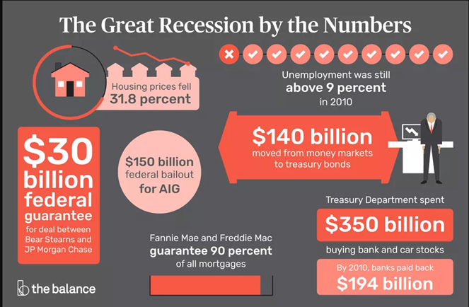
Key Statistics on the Great Recession

Slide 7
The Housing market, Financial markets Commodity and Stock Markets
The value of homes fell way beyond the amount that investors had borrowed from financial institutions
The subprime interest rates rose up steadily.
Mortgage monthly payments doubled in some parts of the country.
Most people lost their homes as they couldn’t pay back the borrowed money.
Notes:
As a result of the recession, home building report a significant decline due to restricted supply of new homes. In the long run this resulted to a new increased demand for new homes since the population was still growing. The crisis in the housing market resulted in economic stagnation.

Slide 8
During the financial crisis, financial markets and the stock markets encountered great losses on investments.
Investors panicked and resolved to sell off their investment in stocks and other financial assets which further escalated the impact on the housing and investment sectors.
Financial institutions and bank succumbed to the market shock and pressure where some of the biggest financial institutions went bankrupt.
The financial markets and stock market end up being unstable for lengthy periods and took the longest to recover from the severe consequences of the financial crisis.
Notes:
The crumbling of the stock and financial market signified the doom period for the economy. Investors register massive losses while the industry suffered huge blows due to the exposure of high volatility. The crisis swept across the wall street, mainstream and the banking sector with large corporation going down the drain and suffering mega losses worth of billions of investments (Bandyopadhyay, 2013). Some of the institutions that went bankrupt includes Bear Stearns, mortgage firm Fannie Mae and Freddie Mac, Countrywide Financial Corp and AIG where the government issued out bail to try and save them from collapsing along with the financial and stock market (Bandyopadhyay, 2013).

Slide 9
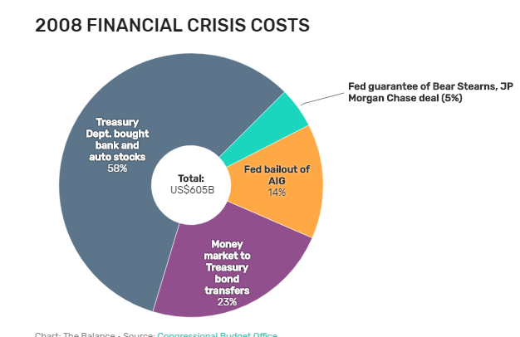
Key Statistics of the Financial Crisis

Slide 10
Measures to curb recession in the Housing Market
Federal reserve purchased US $ 2.5 trillion of government debt and troubled private assets from banks.
Controlled construction of new homes in specific areas.
Imposition of regulatory policies on the mortgages markets and financial sector.
Notes:
In a bid to prevent a recession in the housing market as soon as the crisis manifested, the fed and the treasury moved in to try to salvage the private financial institutions that were crumbling (Bandyopadhyay, 2013). There was an input of $2.5 trillion in debt and bailout from the federal reserves. In addition, the other measures of curbing recession in the housing market involved controlled construction and issuance of mortgage funding as well as regulatory policies to limit the high volatility of the housing industry and the financial markets.

Slide 11
Retail Trade Sector and the Financial Crisis
The implication on the retail industry was immense and it has taken a lengthy period for the global retail industry to stabilize.
The financial sector being central to the funds transfer and transactions of the retail industry sunk down with the retail sector.
The retail sales volume significantly dropped during the economic recession of 2008.
Notes:
As the financial sector crumbled, so did other sectors of the economy. One such industry heavily impacted by the financial crisis is the retail sector where the levels of inflation and unemployment hit the sector the heaviest (Ghadami, Aghaie, & Mohammadkhan, 2010). In particular, online retailing which was fast growing prior to the financial crisis suffered huge blows by the reduction on credits available, decline in consumer expenditure and confidence in the sector and lower savings rates (Puri, Rocholl & Steffen, 2011). Besides, the realization of both inflationary and deflationary effects on the world economies led to the contraction of the retail industry by a greater margin.

Slide 12
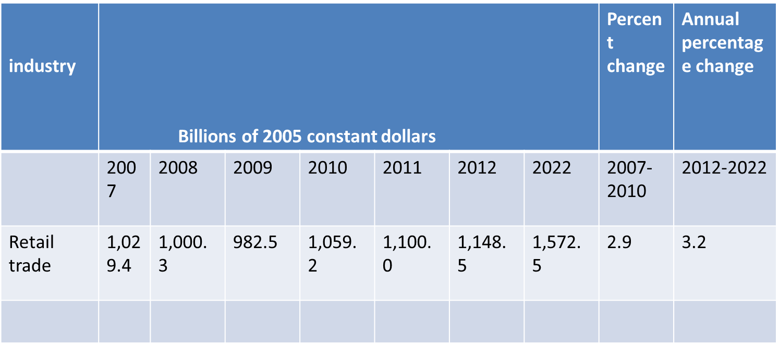
Trend In the Retail Industry
Table 1. Domestic (import-adjusted) personal consumption expenditures
Notes:
From the above table the following can be deduced; in the year 2008 there was a slight decrease in personal consumption expenditures because consumers had less income as there were fewer customers to make purchases. In the year 2009 it was worse as the effects of the recession persisted accompanied by massive loss of employment translating to decrease in consumption expenditures. The retail industry started a revival in 2010 which is signaled by a significant rise in the consumption expenditures. More so, the sector has since been on an upward trend from 2010 onwards and the recovery signifies that the sector is on the right path.

Slide 13
Conclusion
The great recession had a very close relation to its start and spread with housing market. Housing market carried a huge chunk of the negative effects of the recession such drop in home prices, lack of funding from financial institutions while home owners could afford to pay their mortgages.

Slide 14
References
Amadeq, K. (2018). 2008 Financial Crisis. Retrieved from https://www.thebalance.com/2008-financial-crisis-3305679
Bandyopadhyay, S. (2013). Revisiting 2008 Financial Crisis. SSRN Electronic Journal. doi: 10.2139/ssrn.2224599
Campello, M., Giambona, E., Graham, J. R., & Harvey, C. R. (2011). Liquidity management and corporate investment during a financial crisis. The Review of Financial Studies, 24(6), 1944-1979.
Taylor, J. B. (2009). The financial crisis and the policy responses: An empirical analysis of what went wrong (No. w14631). National Bureau of Economic Research.
Ghadami, F., Aghaie, A., & Mohammadkhan, M. (2010). The impact of financial crisis on B2C e-commerce. iBusiness, 2(02), 193.
Puri, M., Rocholl, J., & Steffen, S. (2011). Global retail lending in the aftermath of the US financial crisis: Distinguishing between supply and demand effects. Journal of Financial Economics, 100(3), 556-578.

